Slide 1
SOEN 400·PROJECT PROGRESS CHECK
Retail Customer
Segmentation
Discovering behavioral groups via RFM clustering.
PRESENTED BY
Group 3
METHODOLOGY
Data Mining &Analytics

Slide 2

THE PROBLEM STATEMENT
Beyond one-size-fits-all marketing.
Treating all customers the same wastes marketing effort and misses chances to retain highly valuable groups.
Retail businesses serve thousands of customers who differ widely in how often they buy and how much they spend.Because there are no predefined categories, distinct behavioral groups must be discovered directly from transaction data.

Slide 3



PROJECT OBJECTIVES
Our core analytical goals.
1.Obtain a Describe
Acquire a real retail transaction dataset and understand its underlying structure.
2.Clean Quality Issues
Handle missing IDs,cancellations,invalid values,and duplicate records.
3.Engineer Features
Calculate Recency,Frequency,and Monetary(RFM)variables for each customer.

Slide 4

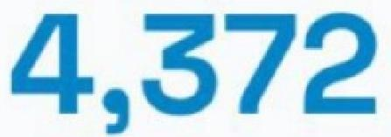

DATA SOURCE
UCI Online Retail Dataset.
This dataset contains all transactions between Dec 2010 and Dec 2011 for a UK-based online retailer.It is highly suitable because it provides transaction-level data
required to build RFM features from scratch.
541,909
Raw rows
1 Year
Timeframe
Unique customers
Variables per record

Slide 5


DATA COLLECTION
Evidence of procurement.
We successfully downloaded the dataset to local disk storage in both xlsx and .csv formats.The .csv file was primarily utilized for EDA tasks within our Jupyter Notebook environment.
EXPLORER
G3 Project
Online Retail.csv
x Online Retail.xlsx
import pandas as pd
>print('Descriptive statistics:')
>display(raw.describe().T)
EDA Jupyter.ipynb
Loaded with encoding='utf-8'
Dataset shape:541,909 rows× 8 columns
Memory usage: 183.71 MB

Slide 6
INITIAL EXAMINATION
Dataset features and shape.
Our initial review confirmed the structure of the data.The dataset is transaction-level,meaning multiple rows belong to the same invoice and customer.Customer-level aggregation is required.
Feature | DType | Non-Null Count | Unique Values
InvoiceNo | str | 541909 | 25900
StockCode | str | 541909 | 4070
Description | str | 540455 | 4223
Quantity | int64 | 541909 | 722
UnitPrice | float64 | 541909 | 1630
CustomerlD | float64 | 406829 | 4372

Slide 7


QUALITY ANALYSIS
Missing Customer IDs.
24.93%
Missing CustomerlDs represent the primary data quality issue.Approximately 25%of records lack this identifier.
Because our objective is customer-level segmentation, transactions without IDs cannot be reliably associated with an individual.
Action:Exclude 135,080 orphaned rows from the
analysis.
0.27%
Description
CustomerlD

Slide 8
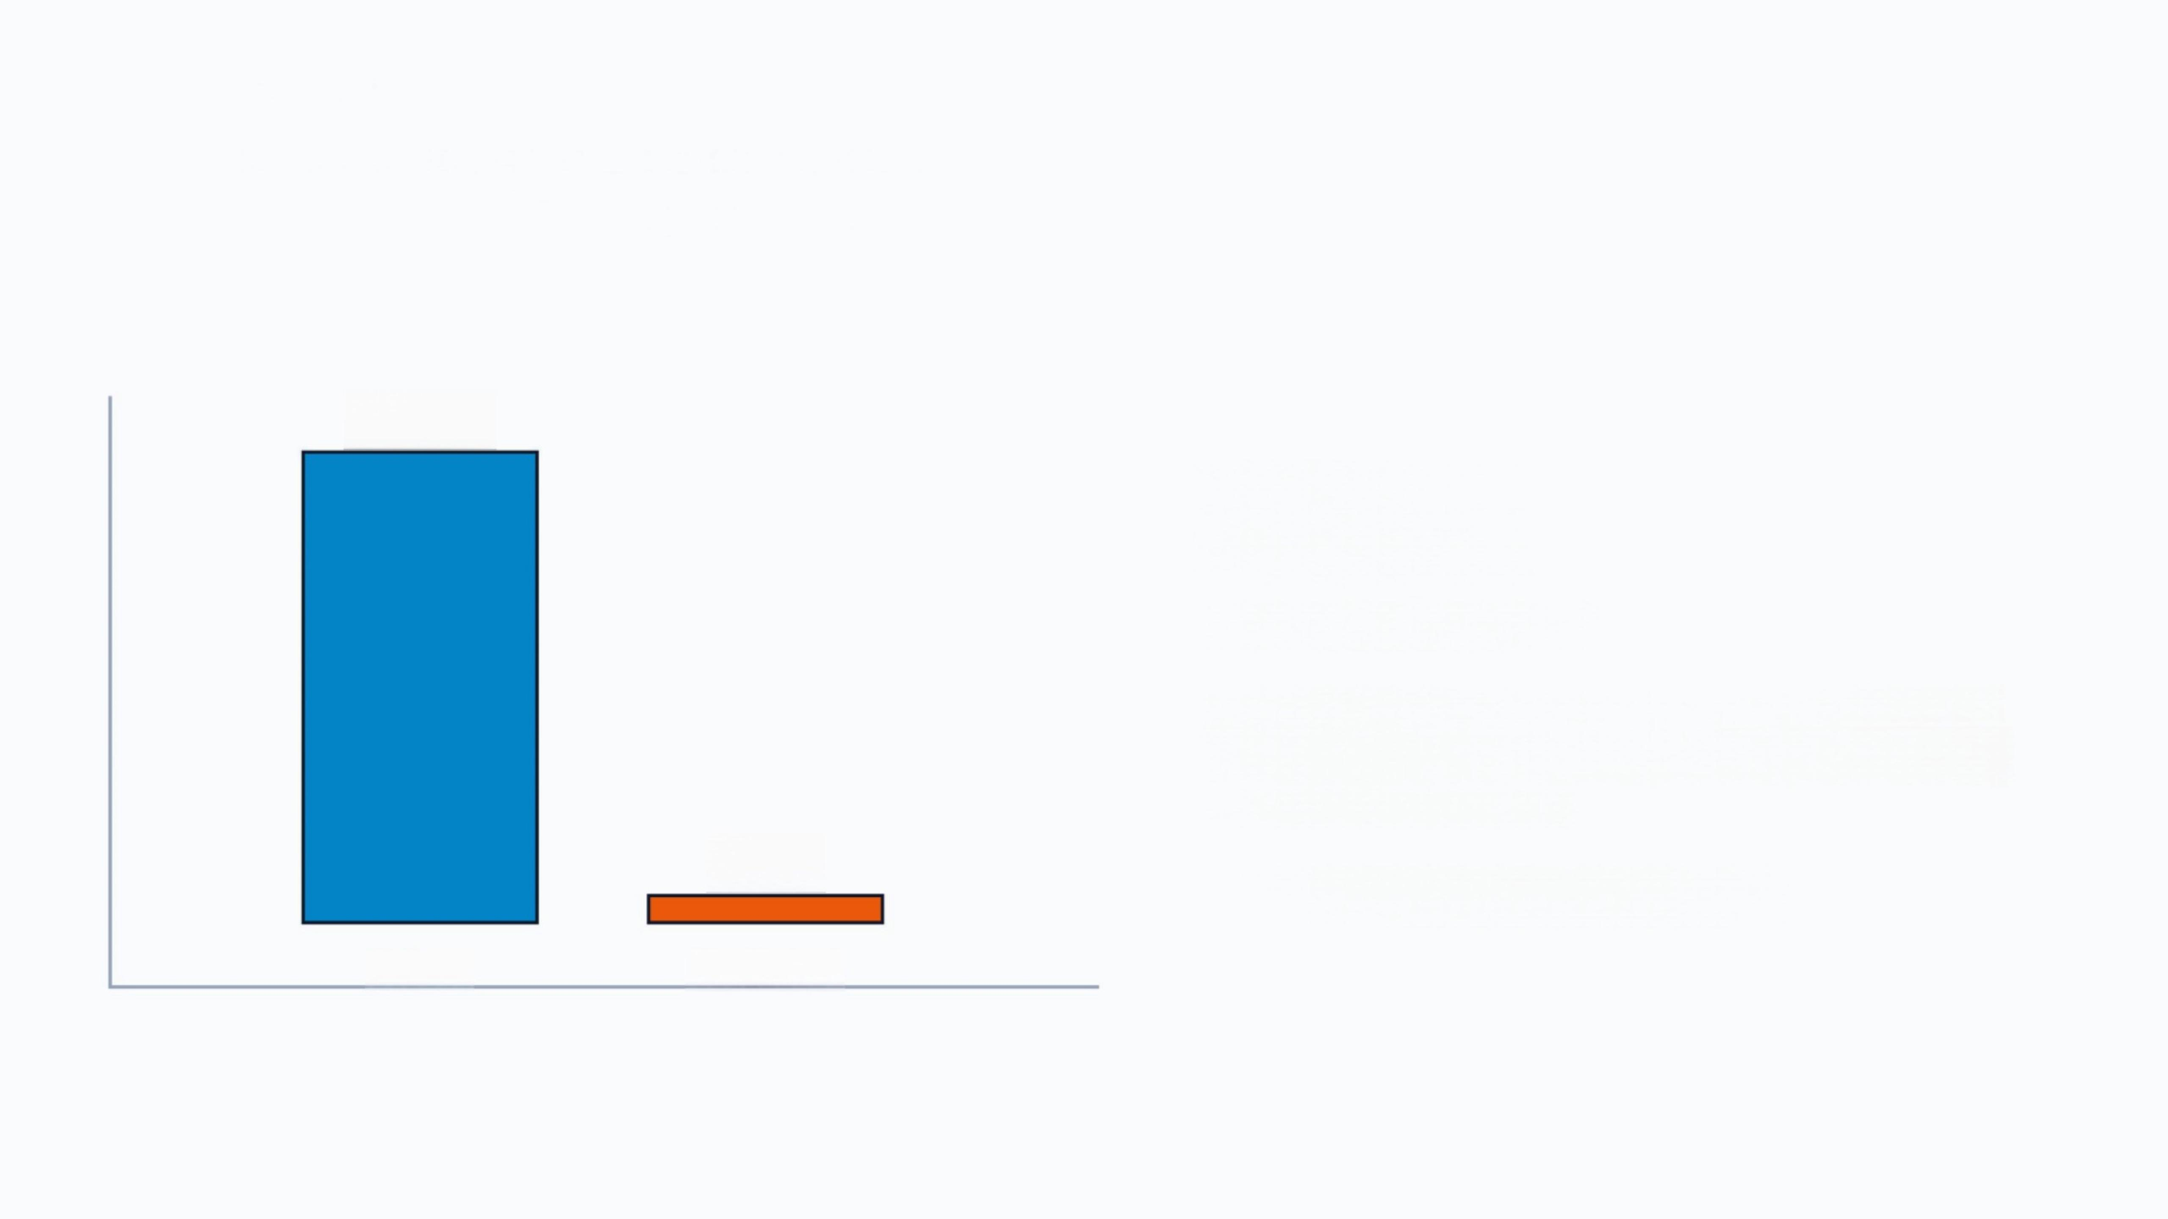
QUALITY ANALYSIS
ldentifying exact duplicates.
536,641
0.97%
Proportion of duplicates.
Though the percentage is small,retaining these exact duplicate records artificially inflates transaction counts and spending measures.
Action:Drop all 5,268 duplicates.
5,268
Unique Duplicated

Slide 9
QUALITY ANALYSIS
Transaction-level anomalies.
Several records contained invalid numeric data that distorts normal purchasing behavior.These must be removed prior to engineering RFM metrics.
Missing CustomerlD | 135,080
Quantity≤0 | 10,624
Cancelled (start C) | 9,288
UnitPrice≤0 | 2,517

Slide 10
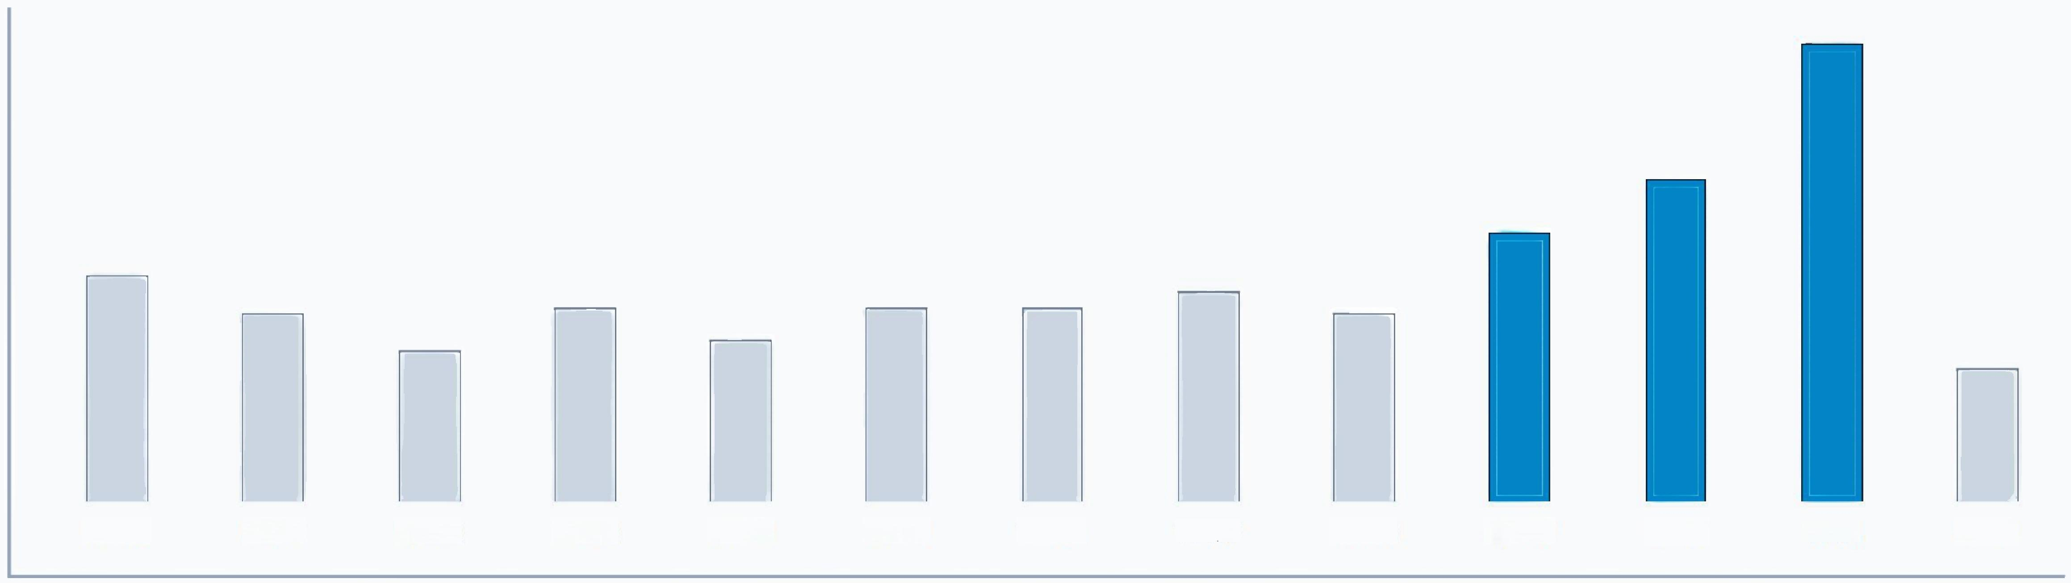
EXPLORATORY ANALYSIS
Purchasing is highly seasonal.
Transaction volume varies drastically over time,showing a sharp spike in Q4.Because behavior is time-dependent, Recency calculations must use a fixed snapshot date.
10-12 11-01 11-02 11-03 11-04 11-05 11-06 11-07 11-08 11-09 11-10 11-11 11-12

Slide 11
FEATURE ENGINEERING
Building the RFM dataset.
After data cleaning,392,692 valid transactions were aggregated to create customer-level Recency,Frequency,and Monetary(RFM)statistics for 4,338 unique clients.
Metric | Mean | Std | 50%(Median) | Max
Recency | 92.53 | 100.01 | 51.00 | 374.00
Frequency | 4.27 | 7.69 | 2.00 | 209.00
Monetary | 2048.68 | 8985.23 | 668.57 | 280206.02
Notice the extreme jump from the 50th percentile(Median)to the Maximum values.

Slide 12
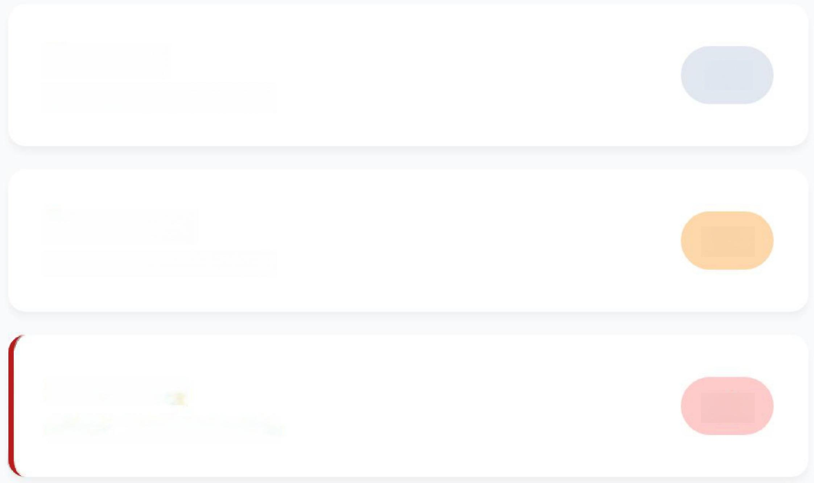
EXPLORATORY ANALYSIS
The customer base is highly uneven.
A small segment of customers drives disproportionately high activity and revenue.
While IQR boxplot analysis flags hundreds of values as
"outliers,"we elected to retain them.High spenders and
frequent buyers represent genuine,valuable behaviors rather than data errors.Transformation will be applied instead of
removal.
Recency
IQR Outliers detected
Frequency
IQR Outliers detected
Monetary
IQR Outliers detected
155
285
425

Slide 13

EXPLORATORY ANALYSIS
Behavior is multi-dimensional.
R F M
R | 1.00 | -0.26 | -0.12 | Customers cannot be accurately segmented using spending alone.Two customers may spend similar amounts but differ wildly in purchase frequency.
F M | -0.26 -0.12 | 1.00 0.55 | 0.55 1.00 | Moderate Positive(0.55): Frequency &Monetary are linked.Frequent buyers tend to have higher overall spending. Weak Negative: Recency operates independently.High spenders are not necessarily recent buyers.

Slide 14
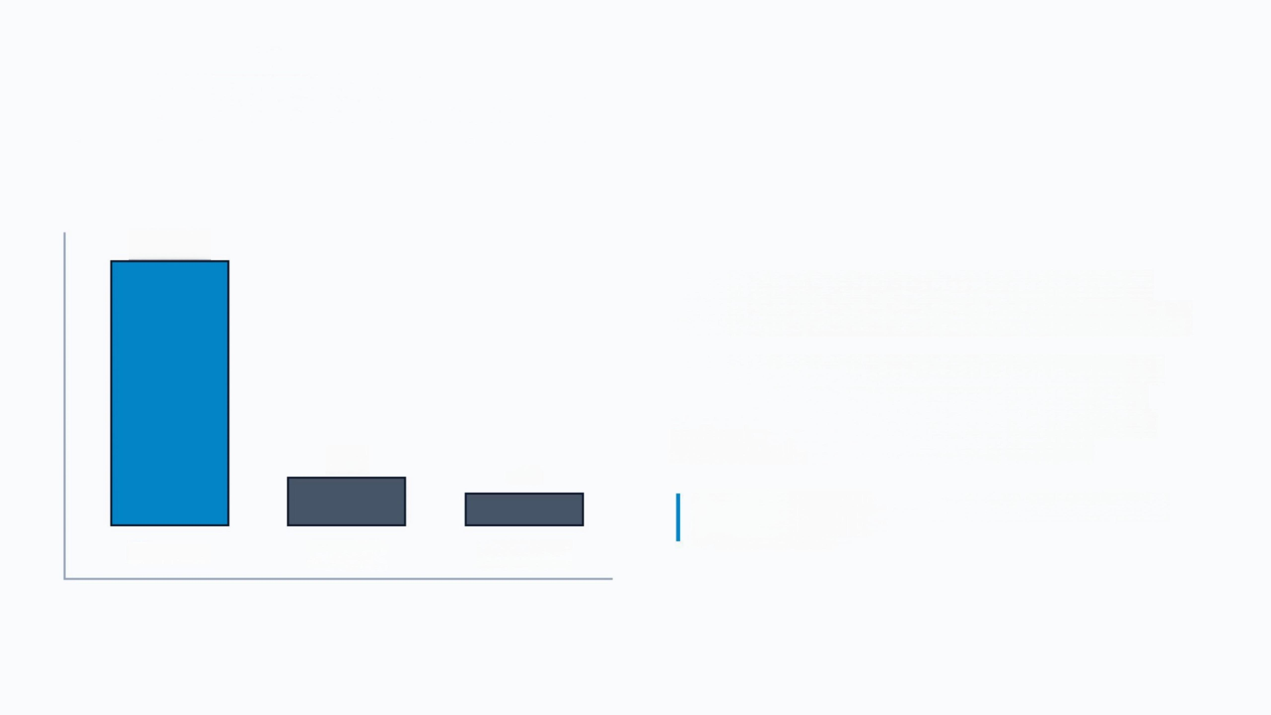
NEXT STEP PREPARATION
Standardizing feature scales.
280,202
373
208
Monetary Recency Frequency
The RFM features exist on vastly different scales.
Monetary range dwarfs both Frequency and Recency.
Because K-Means clustering is distance-based,applying algorithms directly to the raw RFM values would cause Monetary metrics to completely dominate the clustering process,effectively ignoring the other variables.
Resolution:Apply Log Transformation &Standard
Scaling before modeling.

Slide 15


Image Sources
https://media.istockphoto.com/id/1175445207/vector/shopping-people.jpg?s=612 ×612&w=0&k=20&c=GybUaCOwmcbl2 obGpJe4bARvN65e4TaVsmJIT8aWXA= Source: www.istockphoto.com
https://cdn.cxtms.com/blog/2026-emerging-trends-technology.webp
Source: cxtms.com

